Slide 1
CEN 3078 Computer Security
Module 3 – Security Analytics

Slide 2
Security architectures
Moving target defense, Defense by pretense
Anomaly detection
Threat intelligence collection
Penetration testing
Risk assessment and management
Module-3: Discussion Topics

Slide 3
Security architectures
Moving target defense, Defense by pretense
Anomaly detection
Threat intelligence collection
Penetration testing
Risk assessment and management
Module-3: Discussion Topics

Slide 4








Critical Application Infrastructures
Consumer Apps
Online Retail
Health Care
Cloud Computing
And Networking
Advanced
Manufacturing
Gaming
Very large user bases, and web services that benefit societal needs

Slide 5
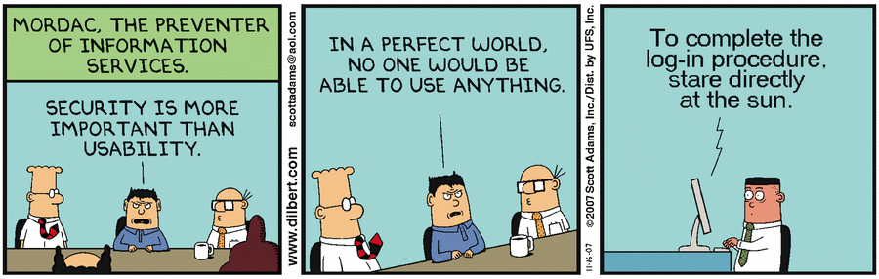
Balancing resilience (security) and user experience (performance/usability)
Security architectures need to build upon fundamental concepts of cyber security, along with their relevance in on-premise and cloud computing infrastructure for different application contexts…
Applications: Public Safety, Media, Manufacturing, Healthcare, SmartGrid, …
5

Slide 6
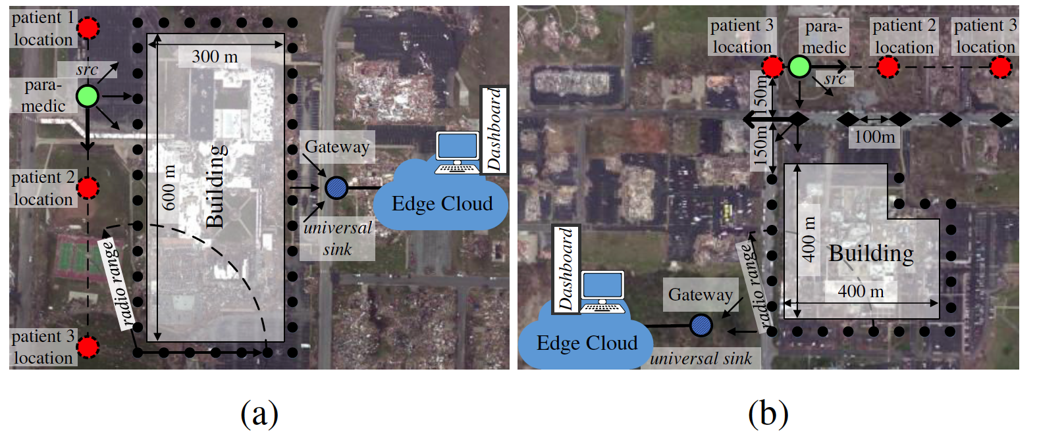
Lightweight and Flexible Security for IoT-based Public Safety Applications
Recreated disaster scenes of tornado damages (in Joplin, MO 2011) at the: (a) Joplin High School; (b) Joplin Hospital
6

Slide 7
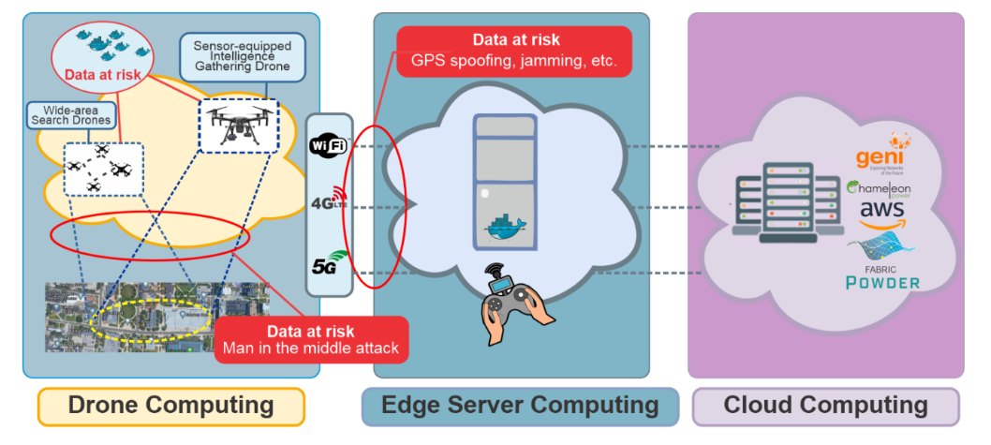
Lightweight and Flexible Security for IoT-based Public Safety Applications
IoT Gateway Middleware that uses machine learning to decide on tradeoffs in energy, latency and security in deciding computing policies at core or edge
A. Esquivel, D. Kavzak Ufuktepe, R. Ignatowicz, A. Riddle, C. Qu, P. Calyam, K. Palaniappan, “Enhancing Network-edge Connectivity and Computation Security in Drone Video Analytics”, IEEE Applied Imagery Pattern Recognition (AIPR) Workshop, 2020.
7

Slide 8
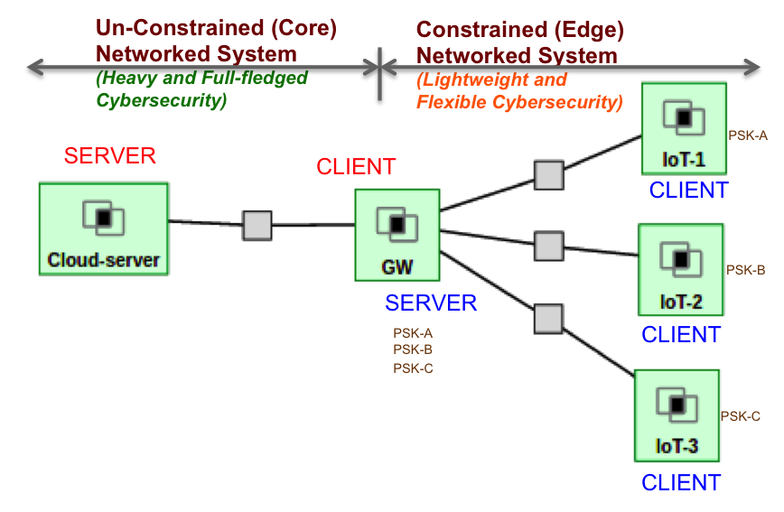
Lightweight and Flexible Security for IoT-based Public Safety Applications
IoT Gateway Middleware that uses machine learning to decide on tradeoffs in energy, latency and security in deciding computing policies at core or edge
Details in Module 4…
8

Slide 9



Media Application: Just-in-time News Feeds
Recent shift in news related media consumption trends
Readers are relying on 'just-in-time news feeds' versus the traditional print medium
Media companies are offering ‘just-in-time news’ feed service for their subscribers who pay money for ‘premium’ content
Particularly popular in sectors such as Finance and Health Care
9

Slide 10
Media Application: Anomaly Detection
Used to detect anomalies occurring in a network path or server
Requires collection of profiles or signatures that represent the normal and abnormal behavior
E.g., number of failed login attempts permissible/occurred for a host, the level of processor usage, and consumed network bandwidth
Email threshold
Bandwidth threshold
Audit Data
Learning engine
Login fail
threshold
CPU usage
threshold
Training period
Profile
alarm
Activity data
Detect engine
pass
Detecting period
10

Slide 11
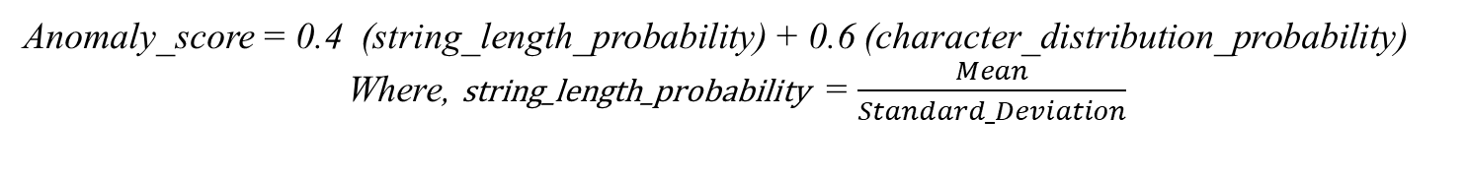
Media Application: Anomaly Detection
“URL Anomaly Detection” checks the abnormality of a URL through detection of the deviation of the character distribution in the received URL string
Training Phase:
Here, the data is trained using some sample URLs
From the URLs, an ASCII map count of each character is generated. This count is used in the Anomaly Detection phase to calculate the String Length Probability and Character Distribution Frequency Probability
Detection Phase:
This phase calculates the Anomaly value for a given input URL
The Character Frequency Distribution uses Histogram model to calculate the Frequency Distribution of each character in the given input URL string
The Anomaly Score is calculated as -
Anomaly_score = 0.4 (string_length_probability) + 0.6 (character_distribution_probability)
Where, string_length_probability = $\frac{Mean}{Standard_Deviation}$
11

Slide 12
Manufacturing Application Security & Privacy
“Agile manufacturing” builds on the benefits of cloud computing (e.g., businesses
Don’t need to invest and manage expensive computing resources or computational solver licenses)
Need to bridge the collaboration gap between Manufacturing App Developer and a Cloud Engineer in “Manufacturing App Marketplaces”
Or AWS, GCP, …
12

Slide 13
Manufacturing App Marketplace Security Architecture
How to secure on-going efforts to scale-up the App Marketplace with user opt-in via a new web-access layer features?
(a) an integrated single sign-on authentication
(b) on-demand/secure access to run virtual desktops, and virtual machines for web servers to host the various Apps
(c) secure storage of results after the computation stages to protect intellectual property of the manufacturers’ App designs and data sets
(d) Defense against LoC using HoneyFiles (Defense by Pretense)
13

Slide 14
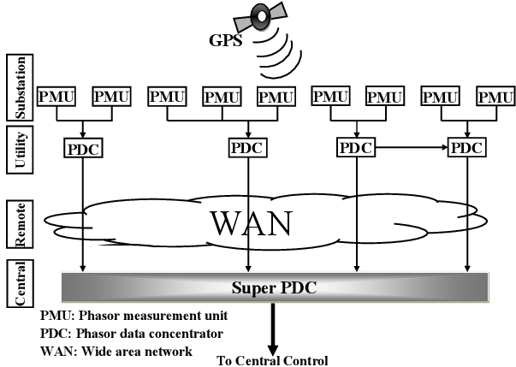
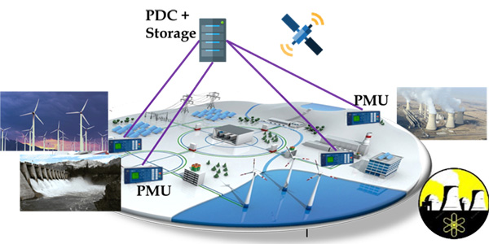
SmartGrid Application
Wide-area measurement and control systems (WAMCS) technology using Phasor Measurement Units (PMUs) is important
Helps guarantee resilience, stability, reliability, state estimation, control, and protection of next-generation power systems
However, there is an exponentially increasing number of PMUs and PDCs being deployed in the North American grid
Result is an explosion in data volume, which needs an efficient wide-area communication and computing infrastructure
14

Slide 15
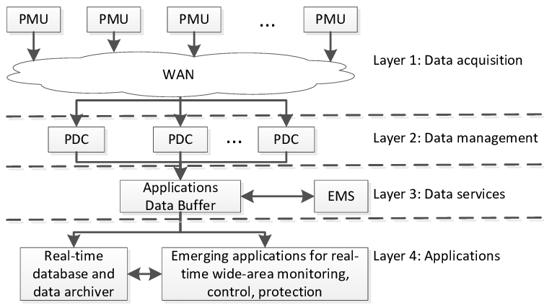
SmartGrid Application
As an example for power grids, according to UCAlug Open Smart Grid, every PMU (from a utility company) requires 600 to 1500 Kbps bandwidth, 20 ms to 200 ms latency, almost 100% reliability, and a 24-hour backup
WAMCS will require cloud computing resources (e.g., storage) and Gigabit per second bandwidth for satisfactory performance and resilience
Challenges are even more aggravated by the gradual transition from centralized to distributed systems for increased speed of data processing
With SDN
Privacy and Non-disclosure issues
15

Slide 16
SmartGrid Security Architecture
How to secure on-going efforts to store and process PMU data with utility companies opt-in via a new web-access layer and software-defined network features?
(a) an integrated single sign-on authentication
(b) on-demand/secure access to computation in the cloud to calculate e.g., secure state estimates in the power grids
(c) secure storage of results after the computation stages to protect intellectual property of the utility company’s data sets
(d) Defense against LoC attacks using Role-based Access Control
16

Slide 17
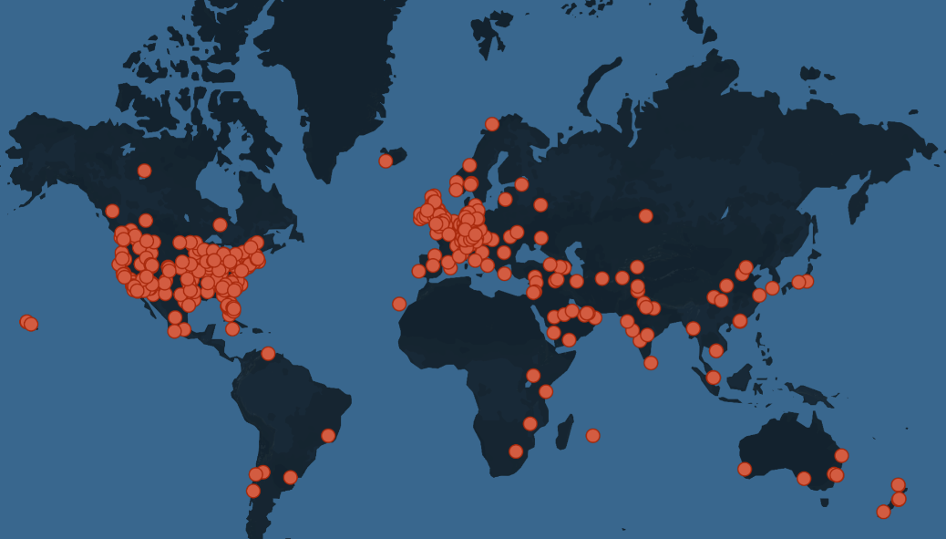
Drone Applications: Security Concerns
2015: A drone flew into the power line and causes 3 hours of black-out of several hundred houses in West Hollywood, near Los Angeles.
2016: Drone slam into Seattle's Space Needle.
2017: A drone fragment got caught in the front wheel of one of the cyclists, causing him to go over the handlebars.
2017: An accident that happened in 2017 in the Canadian province of Quebec, no eyewitnesses were present to prevent a drone collision. [3]
2019: Drone Crash into Las Vegas Stadium Causes $10K Damage
2021: Drone Slams into Building in World Trade Center
Fig. 1 Worldwide Drone Incidents, drone-related incidents and intrusions from around the world [2]
[2] https://www.dedrone.com/resources/incidents/all
[3] https://www.kaspersky.com/blog/drone-incidents/29000/

Slide 18
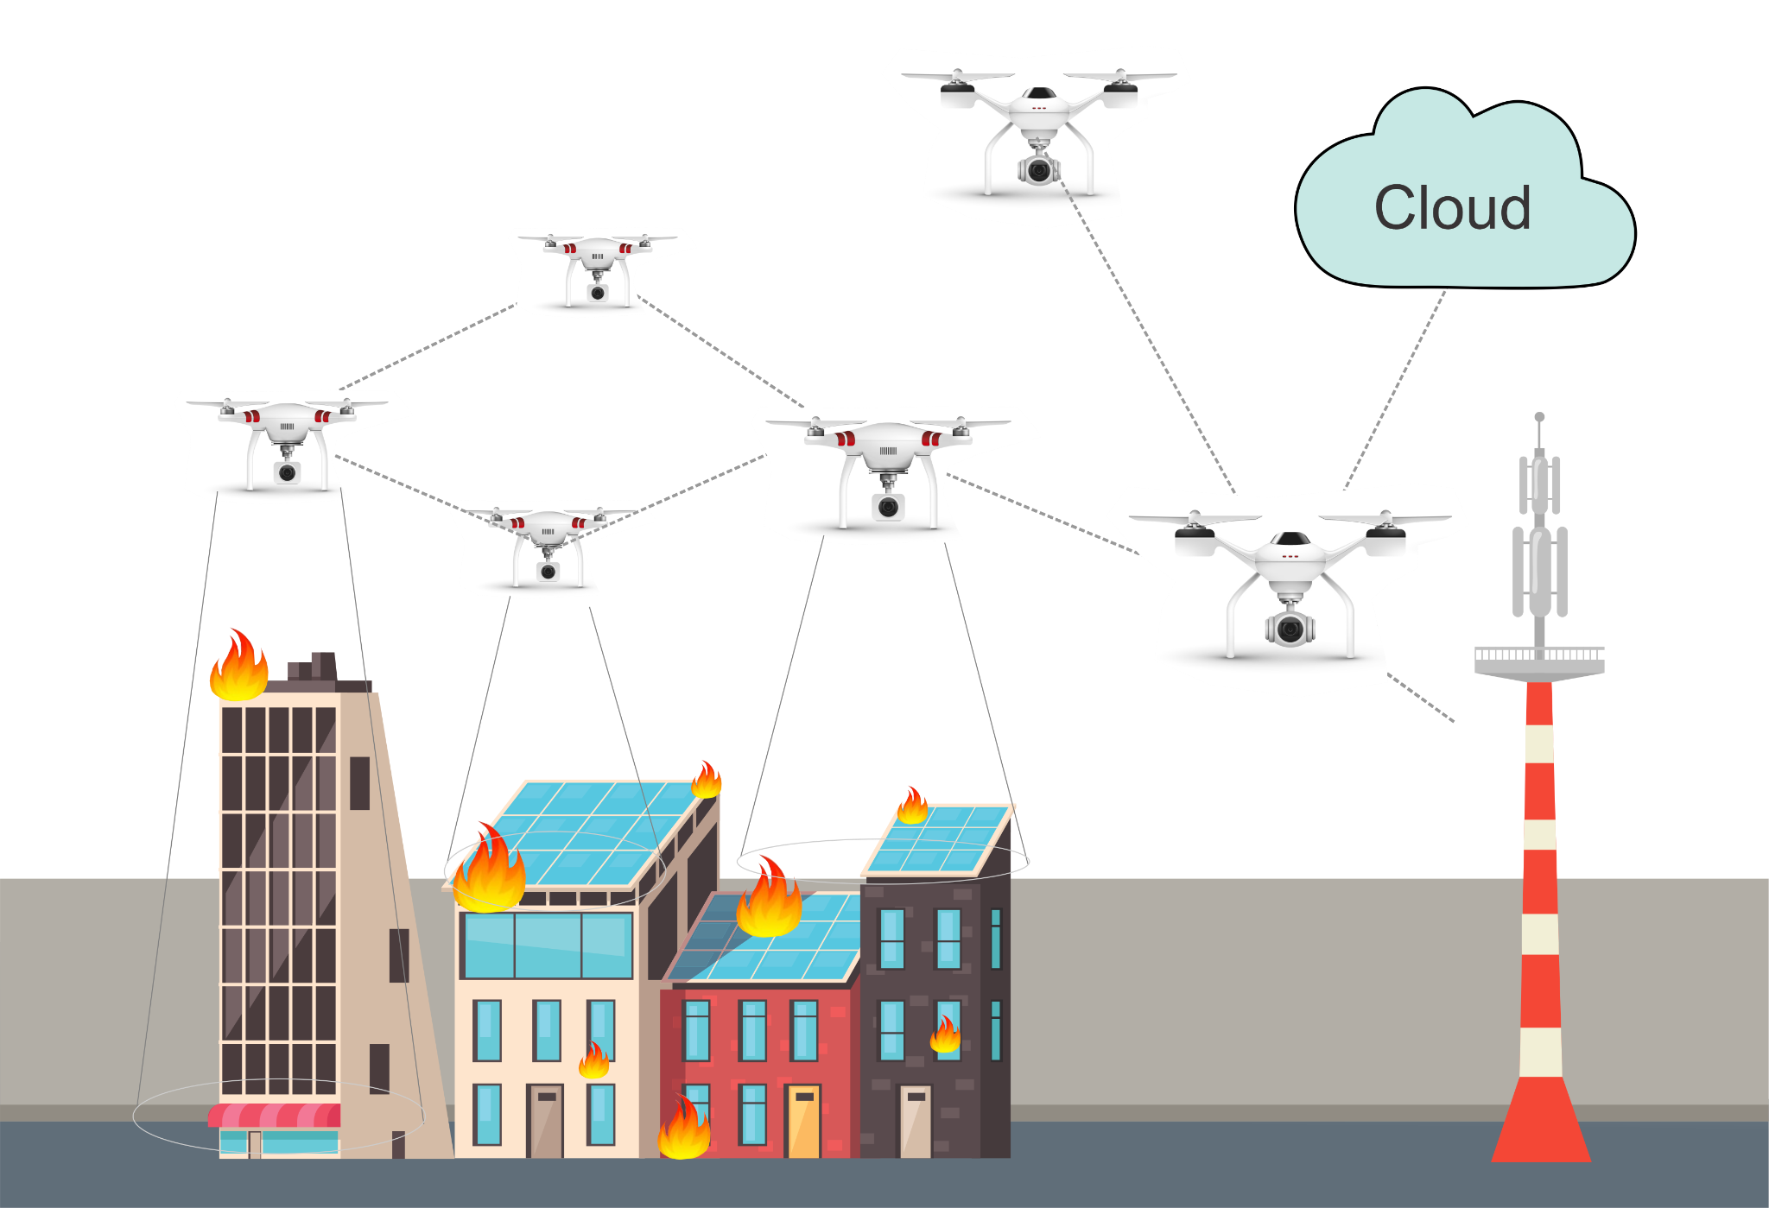
Drone Applications: Security Concerns
Drone swarms or collaborative drone systems with high-resolution video cameras are used for many operations such as precision agriculture, aerial imaging, and critical applications such as disaster scenarios or rescue response
Drone swarms can also provide and facilitate communication in areas where terrestrial infrastructure is poor or has been destroyed.
Drone swarms and their integration with cloud/edge infrastructure accomplishing collaborative missions.

Slide 19
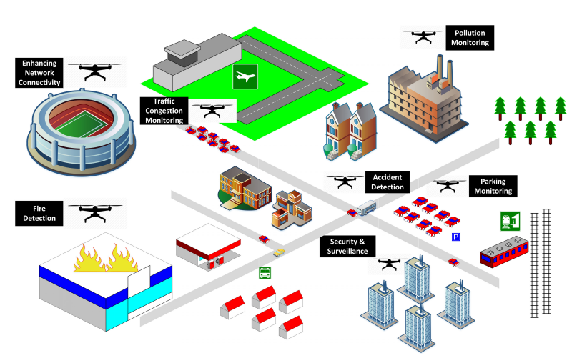
Motivation on Collaborative drone systems
Pollution
Monitoring
Collaborative drones and IoT play a vital role in supporting a lot of smart city applications such as those involved in communication, transportation, agriculture, safety and security, disaster mitigation, environmental protection, service delivery, energy saving, e-waste reduction, weather monitoring, healthcare, etc. [4]
Enhancing
Network Connectivity
Traffic
Control
Monitoring
Accident
Detection
Packing
Monitoring
Fire detection
Security
And
Surveillance
Fig. 3 Collaborative drone and IoT for improving the smartness of smart cities[7]
[4] Alsamhi, Saeed H., Ou Ma, Mohammad Samar Ansari, and Faris A. Almalki. "Survey on collaborative smart drones and internet of things for improving smartness of smart cities." Ieee Access 7 (2019).

Slide 20
Security and challenges in Collaborative Drone Systems
The use of these systems has been increasing and the issues related to security, privacy, reliability, regulation, and ownership are also increasing at the same pace [5].
Furthermore, collaborative drone systems are usually resource-constrained, in addition to being highly vulnerable to physical and cyber attacks/threats.
Challenges exist to secure the communication in collaborative drone services in terms of privacy leakage, data confidentiality protection, and the lack of development and implementation of mechanisms for reliable and secure protocols [6].
[5] Hassija, V., Chamola, V., Agrawal, A., Goyal, A., Luong, N.C., Niyato, D., Yu, F., & Guizani, M. (2021). Fast, Reliable, and Secure Drone Communication: A Comprehensive Survey.
[6] C. Lin, D. He, N. Kumar, K. R. Choo, A. Vinel, X. Huang, "Security and Privacy for the Internet of Drones: Challenges and Solutions", IEEE Communications Magazine, Vol. 56, no. 1, pp. 64-69, 2018.

Slide 21
Attacks on Drones
Attack Vectors
How these attacks are performed
DoS
Throughput is decreased. The communication between UAVs and the GCS is slowed and eventually, it will go out of service.
The attacker changes the GPS location information in the packets causing the target UAV to change its target destination (sending information to another agents, or making it crush to an entity)
MITM
Black Hole
This malicious node begins to beacon with the other UAVs in the swarm, and show high levels of energy, consistent on the protocol activity, causing the UAV to run out of energy before reaching the destination or accomplishing the task.

Slide 22
Zero Trust – One way to solve all
Modeling threats that focus on
Zero Trust - Defense Mechanisms
Check for a maliciously high data rate of packers from any UAVs in the network. If a drone is found to be send packets at a rate greater than the threshold, the node is blacklisted from the network and the updated blacklist will be sent to the remaining drones in the network.
Compares the energy levels of the drones in the network with a predetermined energy threshold based on the known energy capabilities of the UAV. If the energy level of a UAV is greater than the threshold, then the node is blacklisted from the network.
Apply message authentication by using a hash value for each packet and an algorithm to enforce policies if the message integrity is violated.
Detection
Prevention
Mitigation

Slide 23
Security architectures
Moving target defense, Defense by pretense
Anomaly detection
Threat intelligence collection
Penetration testing
Risk assessment and management
Module-3: Discussion Topics

Slide 24
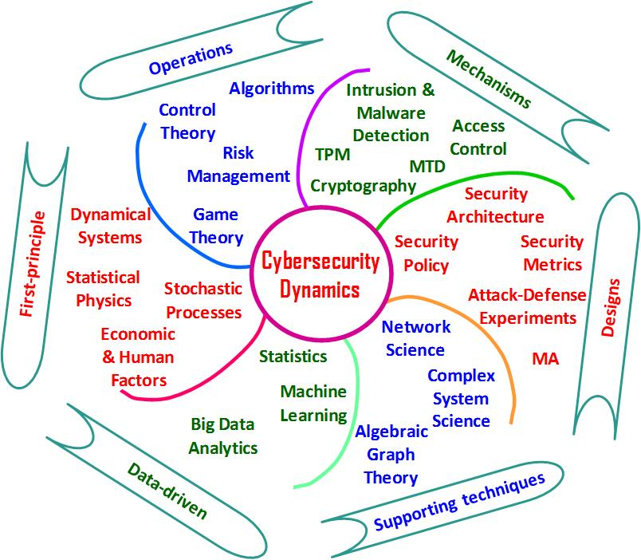
Data Science/ML and Cybersecurity
Data science/machine learning is critical to reveal “evidence” in cyber attack incidents
Without (good) data, there is no knowledge
Time-series data can be valuable for descriptive and predictive analytics of anomaly events
Useful for malware research, penetration testing, etc.
Threat intelligence collection supported by data is critical for decision making in real-life cyber operations/risk management
Helps cybersecurity engineers prioritize and focus on critical events than working by instinct
Many large organizations are hiring data scientists to help with cybersecurity analytics
24

Slide 25
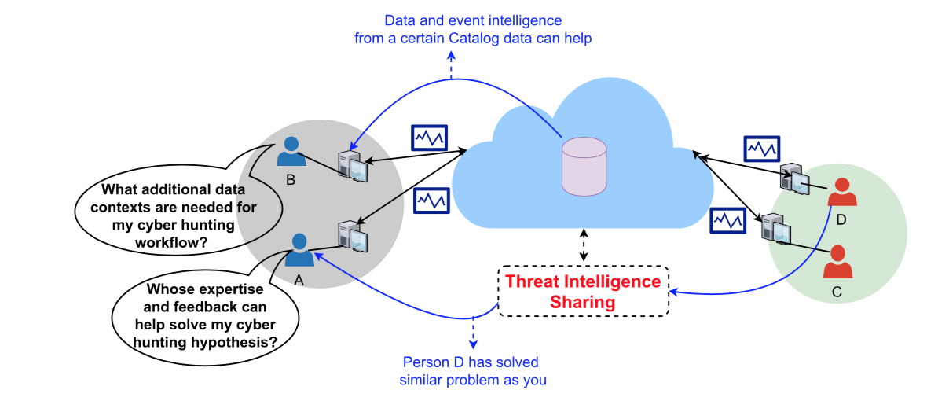
Data-driven Cyber Intelligence Collection
Threat intelligence sharing helps a cyber analyst’s monitoring objectives for ‘soft critical events’ and ‘silent critical events’ relating to either performance bottlenecks that may relate to security incidents…
25

Slide 26
Data-driven Cyber Intelligence Collection
Need to use statistical data planning policies in systems by considering variations of data structures of the many data silos involved
Active measurements (ping, traceroute, Iperf or other such one-end or double-end measurement probing)
Passive measurements (Netflow records, DNS, pcap, host logs, crash dumps, process logs, memory logs)
Monitoring objectives drive network and host device data collection, storage and analysis/visualization in cyber threat hunting
”Data farming” needs to be synergistic to “Data mining”
Monitoring strategies for expected performance/safety assurances violations due to ‘soft failures’ or ‘silent failures’
Versus ‘hard failures’ or ‘failure alarms’ where faults are more apparent to operations personnel using traditional monitoring systems or intrusion detection systems
26

Slide 27
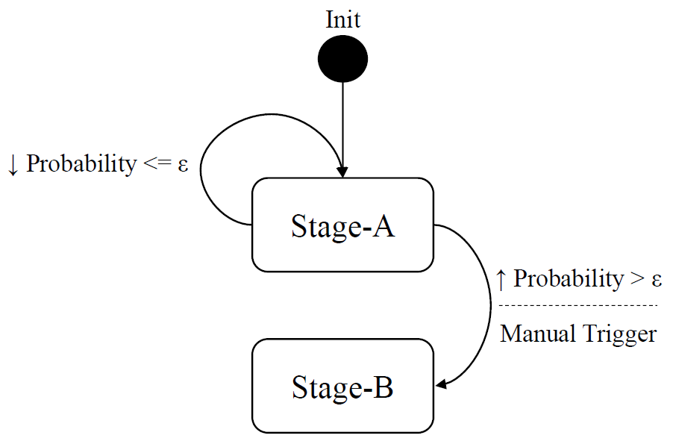
Two-stage Ensemble Learning
Attack feature analysis is done using a two-stage ensemble learning scheme:
Stage A: Outlier Detection
Stage B: Outlier Classification
Epsilon is probability that an event is an outlier – it is tuned in the training phase
If probability is higher than epsilon or if it is manually triggered, the scheme enters Stage B
27

Slide 28
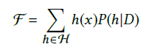
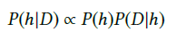
Outlier Detection
Composition of many efficient, multivariate outlier detectors or hypotheses functions
Detect network-wide correlated anomaly events
Functions:
Ensemble of hypotheses
Final ensemble result
Attack probability function
The posterior probability is proportional to the likelihood of the training data D times the prior probability of h
28

Slide 29
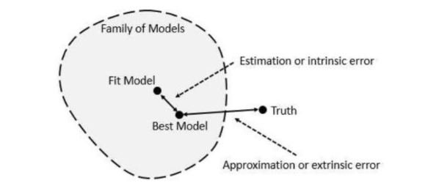
Outlier Classification
Detected attacks are classified into either:
Interesting events (e.g., attacks)
Erroneous conditions (e.g., router failure)
If final ensemble results of consecutive events fall in same range, we classify as an attack, else the events are ignored
NOTE: Ground truth (in addition to high quality data) is extremely important in order to evaluate the accuracy of detected attacks
29

Slide 30
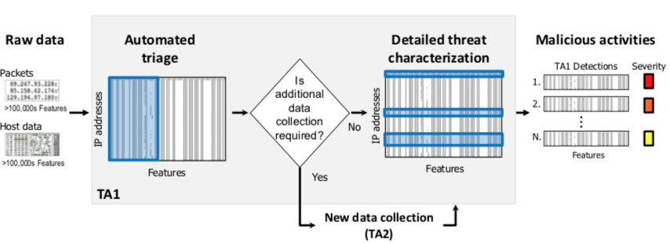
Threat Detection and Characterization
Efficiently detect and characterize cyber threats in a manner that adapts to available data and resource limitations - “sensors for right data at right time”
Detect malicious actions that threaten the integrity of enterprise networks through techniques that integrate information from both networks and hosts
30

Slide 31
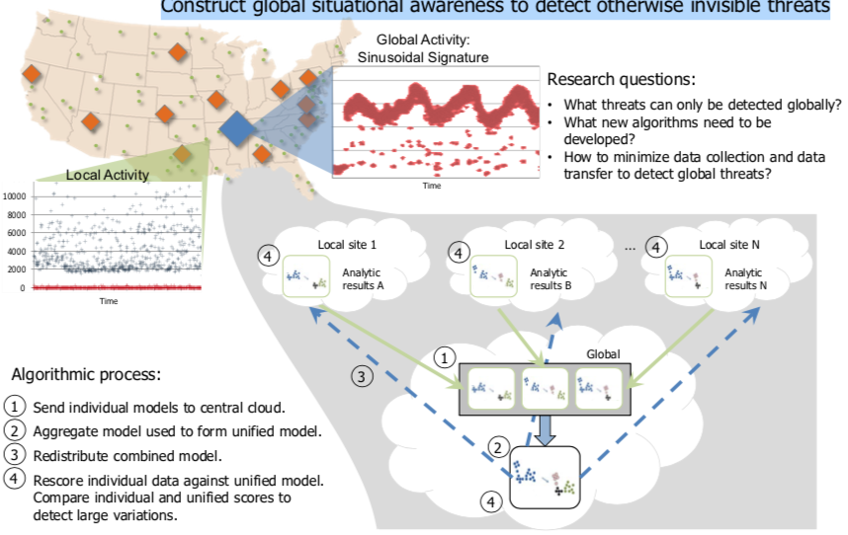
Global Analysis of Threats
Construct global situational awareness to detect otherwise invisible threats
Focus on malicious activity that is invisible from the perspective of a single network, but becomes apparent when multiple systems share the right data
Address what computations need to occur locally, what information must move between locations, and what computations must occur at a central repository
31

Slide 32
Emerging AI Technologies for Cyber Hunting
AutoML - capability of automating the process of building, deploying, and managing machine learning models
Amazon SageMaker, Big Squid (self-service ML workbench), RapidMiner (visual ML workflow designer)
Augmented Intelligence - human-centered partnership model of people and AI working together
Enhance cognitive performance, including learning, decision making, and new experiences
Explainable AI - an ensemble of methods that make black-box AI algorithms’ outputs sufficiently understandable
Edge AI - use of AI techniques embedded in IoT endpoints, gateways, and edge devices to act on sensor data
Applications in streaming analytics for “right data at right time”
https://cra.org/ccc/wp-content/uploads/sites/2/2019/08/Community-Roadmap-for-AI-Research.pdf

Slide 33
Amazon SageMaker
Amazon SageMaker - fully managed service to label, build, train, and deploy ML models quickly
Amazon SageMaker Notebooks, Active learning for ground truth

Slide 34
Explainable AI (XAI)
ML models in new age of applications are opaque, non-intuitive
XAI improves understanding, trust for people

Slide 35
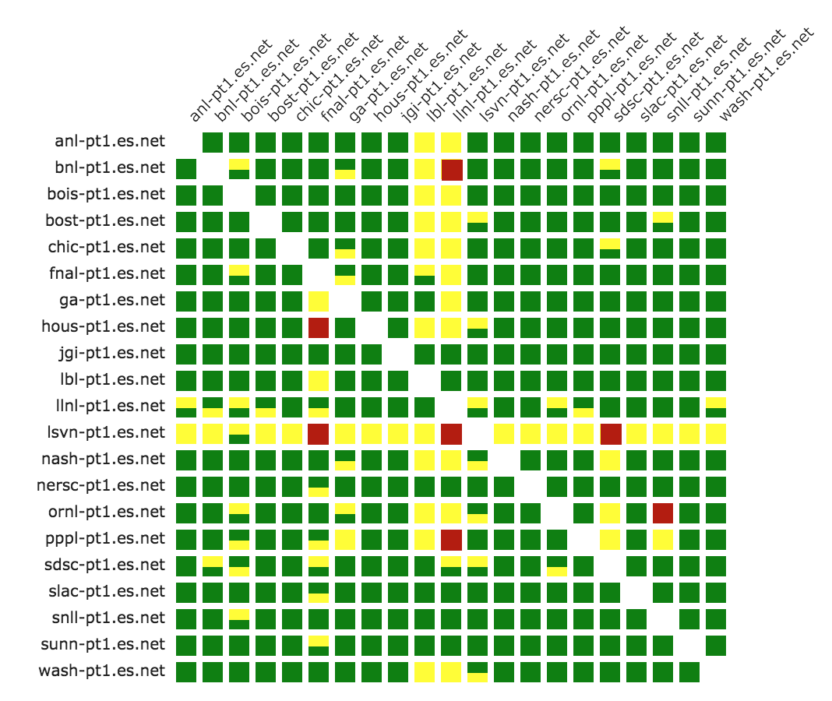
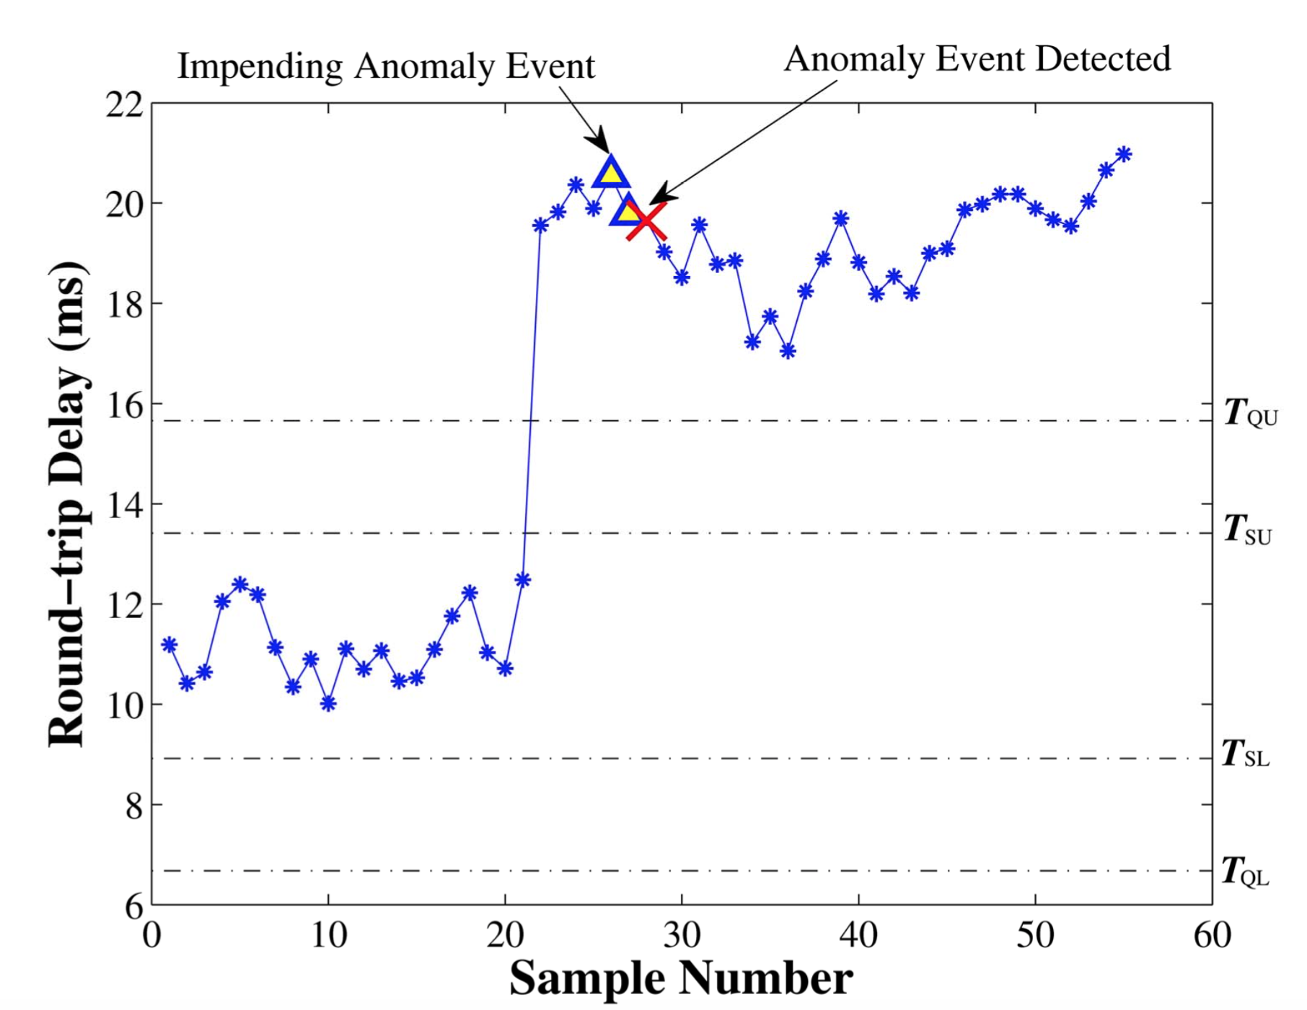
Explainable AI (XAI) Case Study
Anomaly detection → network-wide bottleneck event diagnosis or cyber attack detection/mitigation
→

Slide 36
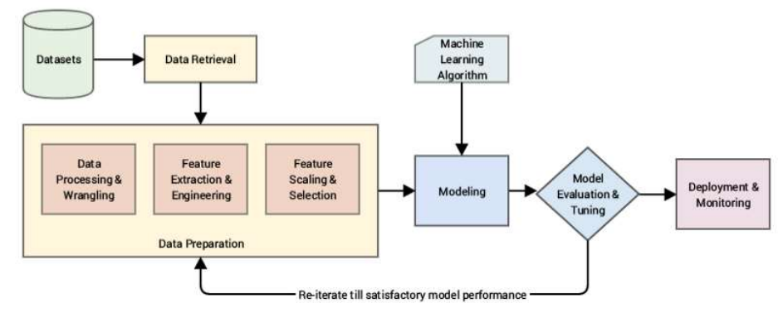
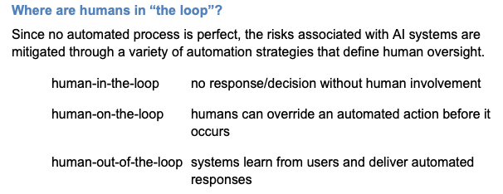
Typical ML Steps
Data used to test a system should be representative of the data the system will see
ML for Cybersecurity Videos: https://www.youtube.com/channel/UC6qyO5J_rObFJewJWs89XRA/videos

Slide 37
Common Anomaly Detection Analysis Schemes
Statistical Techniques
Identify anomalies without assuming a stochastic model in the measurements
Classification Techniques
Identify the root-cause of anomalies through behavior observation (uses offline training/labeling; online testing on unlabeled measurements for category assignment)
Clustering Techniques
Category is not known apriori but placing data points that are similar close to each other – create category based on some distance function
Expert System Techniques
Root-cause analysis by imitiating knowledge of human expert; rule-based or model-based
Graph-theoretic Techniques
Causality (cause-effect) or dependency graph representations; algorithms help test various hypotheses or data perspectives

Slide 38
AI System: “Smart” Workflow to Knowledge-driven Decision Making
Sensing (Assess/Data)
Recognize important patterns/events in space and time
Filter out the noise
Trust in the data
Reasoning (Infer/Learn)
Turning patterns/events and their relationship into knowledge
Logic-based inference / evidence-based inference
Local/global situation assessment / similarity checking
Building/using knowledge base/catalog with successful example cases
Acting (Predict/Fix)
Establish communication goal and generate dialog for a specific crisis
Planning / Problem Solving using model predictions
Robotic Control using software-defined technologies

Slide 39
Security architectures
Moving target defense, Defense by pretense
Anomaly detection
Threat intelligence collection
Penetration testing
Risk assessment and management
Module-3: Discussion Topics

Slide 40
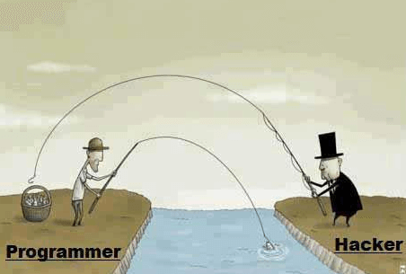
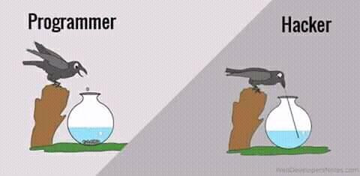
Hacking Humor Hackers find a way!
Minimum human supervision

Slide 41
Ethical Hacking (Recall)
Ethical hackers learn and perform hacking in a professional manner, based on the direction of the client, and later, present a maturity scorecard highlighting their overall risk and vulnerabilities and suggestions to improve
New worms, malware, viruses, and ransomware are multiplying every day and creating a need for ethical hacking services to safeguard the networks of businesses, government agencies or defense
An Ethical Hacker answers the following questions:
What kind of vulnerabilities does an attacker see?
What information or system would a hacker most want access?
What can an attacker do with the information?
How many people notice the attempted hack?
What is the best way to fix the vulnerability?
Minimum human supervision
https://www.eccouncil.org/ethical-hacking/

Slide 42

Types of Ethical Hackers
White Hat Hacker
Do not intend to harm the system or organization but they so, officially to penetrate and locate the vulnerabilities, providing to fix them and ensure safety
Black Hat Hacker
They are non-ethical hackers performing hacking to fulfill their selfish intentions to collect monetary benefits
Grey Hat Hacker
Combination of white and black – they hack without any malicious intent for fun; don’t use approval from a targeted organization and publicly disclose any vulnerability
Minimum human supervision

Slide 43
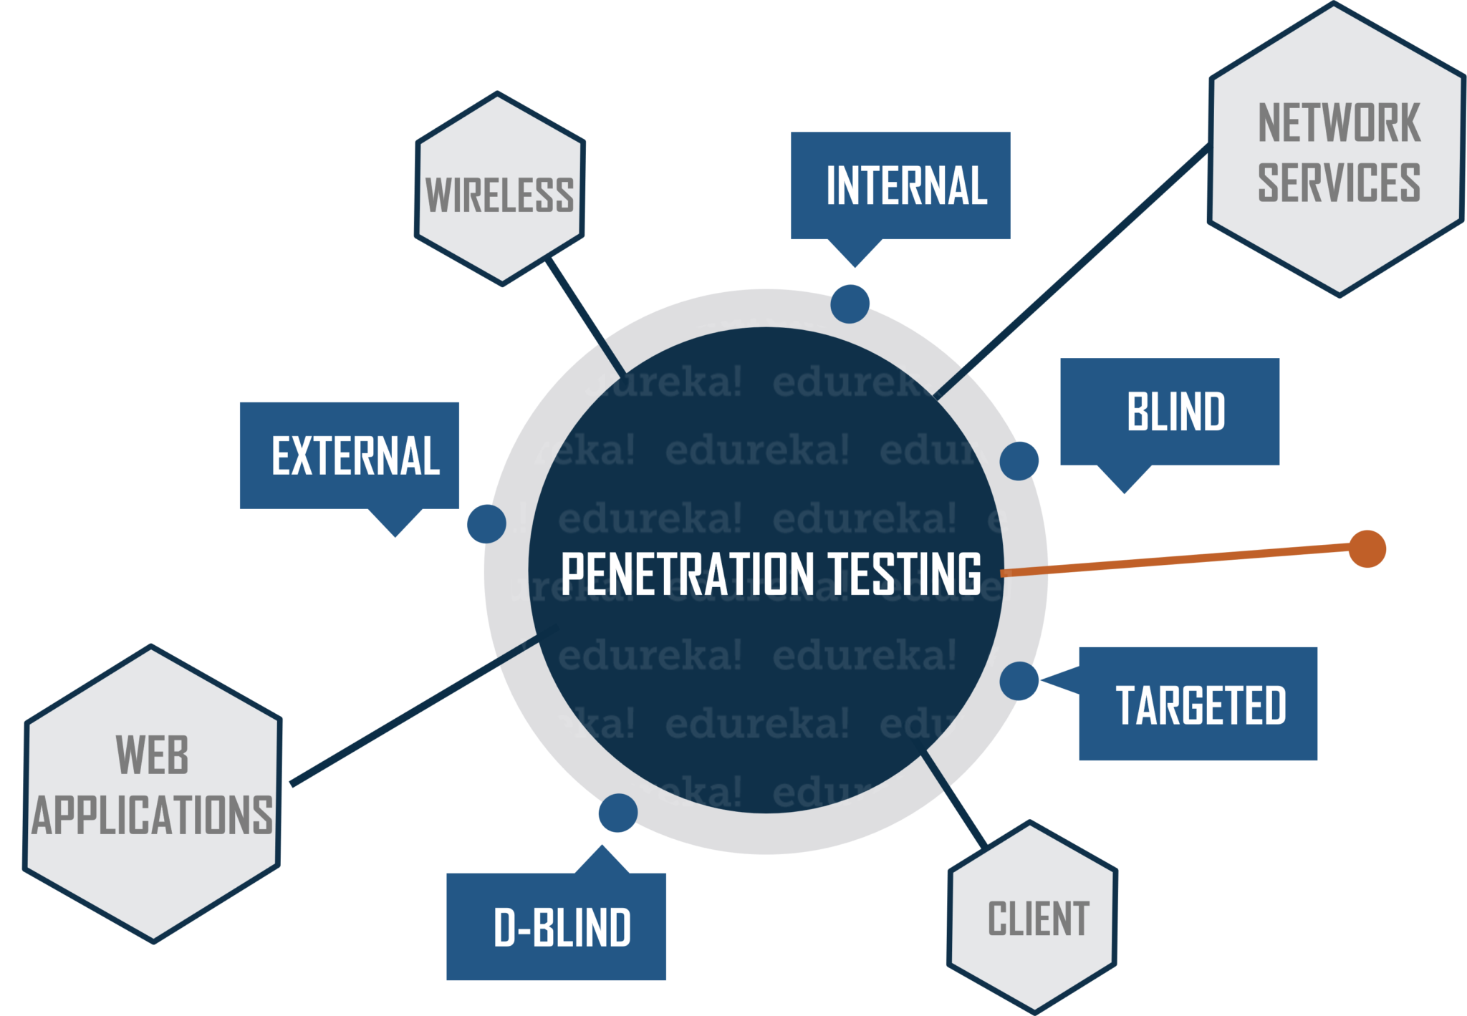

Penetration Testing / Pen Testing
Evaluate security of an IT infrastructure by safely trying (i.e., ethical hacking) to exploit vulnerabilities with written permission
Performed at different levels e.g., OS level, web apps level, wired/wireless network services level, end-user level, …
Assessment to help identify misconfigurations, risky user behavior and validate the efficacy of defense mechanisms
Goal is to find vulnerabilities before any attacker
Two types of Pen Testing
Black box: testing external components targeted with public or zero-day exploits (Black Hat)
White box: testing internal components (White Hat)
Could combine for Grey box testing
Minimum human supervision

Slide 44
Penetration Testing / Pen Testing
Manual or automated approaches are used
Pen tester goal is to exploit a particular vulnerability and use compromised hosts to launch new exploits at other internal resources
Document the combination of vulnerabilities exploited in a particular sequence
Testing ends if highest level of privilege escalation or highest levels of security clearance is attained
A report is produced for decision makers with:
Exposed vulnerabilities in terms of attack surfaces
Strategic conclusions on impact on business and operations
Priorities for remediation against threats and attack vectors
Approvals needed for fixes
Notifications are sent to relevant stakeholders e.g., senior management, vendors of hardware/software
Pen Tester must close out work (e.g., backdoors to maintain access, etc.) to avoid someone else from exploiting the vulnerabilities later
Minimum human supervision

Slide 45
Penetration Testing Steps
Information Intelligence
Using tools such as nmap, nslookup, people finders/Google search
Performing people profiling to target (e.g., via email or phone) as part of social engineering
Scanning and Enumerating
TCP and UDP port scanning to learn about target environment and find exposed vulnerabilities
Using tools such as metasploit, nc, nessus for high-speed discovery, configuration auditing, asset profiling, sensitive data discovery
Advanced Fingerprinting
Advanced fingerprinting of web applications, DNS, load balancers, etc. using scanning methods
Vulnerability Assessment
Overlaps with Pen Testing but largely non-intrusive to identify vulnerabilities in systems/networks and analyze security posture
Minimum human supervision

Slide 46
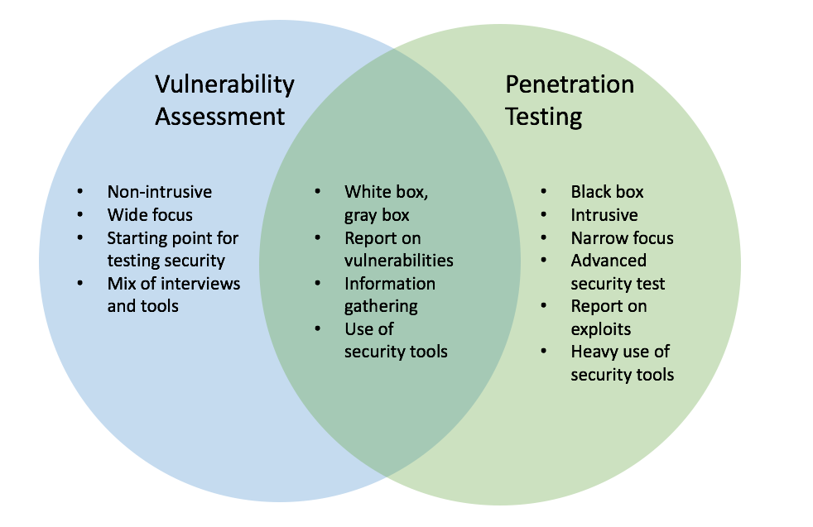
Vulnerability Assessment and Penetration Testing (VAPT)
Which one to choose and when, VA or PT? How do they differ from a security audit to check compliance with standard security policies and procedures?
Minimum human supervision
Automated/cheaper, minutes, scheduled, passive, “breadth over depth”
Popular Tools: Nessus, OpenVAS, Nikto, SAINT
Often manual/expensive, days, opportunistic/intuitive, aggressive, “depth over breadth”
Popular Tools: Metasploit, Kali Linux, NetSparker, Core Impact, Aircrack-ng, John Ripper, backtrack, wireshark
Notes:
Example:
We shall get into a real-life example to understand the difference between the two.
Let’s take Mr. X for an example. Mr. X is a heist specialist. We shall observe his plan for his next heist. He is planning to rob a Bank present in the middle of the city.
The Bank building is surrounded by a Police station, a Fire station, a Public Park [which stays closed at night] and a Pond. The bank building is a 20 floored building with a helipad on the top of it. Before he actually robs the bank, he needs to find the possible entry points into the Bank building.
The sides of the building that has a Police station and Fire station are impossible to breach. They operate 24X7 and who would dare to rob a bank using Cop’s den as the entry point! That leaves Mr. X with 3 other options. Yes, you got it right. He is also having the Roof as an Entry point [Remember Heath Ledger from the Batman Trilogy?].
The Rooftop seems to be an odd choice here as the building is only 20 floored and the chances of getting caught from people around you is very high. And, the Bank is the only single high rise building standing in the area. So, that makes the Roof entry a big NO! With the two leftover options, Mr. X starts analyzing the Lake as an entry point.
Lake can be a good mode of entry but, the visibility would be a concern. How would someone react if they see someone swimming at the midnight, that too towards the Bank building? The last option is the Public Park.
Let’s analyze the park in detail. It is closed to the public after six in the evening. Park has a lot of trees which gives the necessary shadow and supports for stealth mode. The park has a boundary wall which is shared with the Bank premises.
Now, all the analysis above can be said as Vulnerability scan. A scanner does all these things. To find out a vulnerable position to get in.
Going back to our story, let’s assume that Mr. X becomes successful in entering the bank through the Public park entry point. What does he do next? Whether he breaks into the Vault to get the cash or the deposit lockers to get the valuables.
This part is the Penetration testing. You get the access and try to exploit the system. You get to know the depth that you can go with this attack.

Slide 47
Vulnerability Assessment – dealing with Myths
“I have a firewall or use anti-virus to fend off attacks”
+) Firewalls can be effective to mitigate threats and isolate/protect
-) Hackers understand firewall strategies; can take down or by-pass a firewall through exploiting software bugs or admin oversight
-) End-to-end session hijacking not detectable by firewalls
“Web security is handled by using HTTPS”
+) Encryption of communication from source to destination is secure
-) Not effective against DDoS, brute force attacks, SQL injection
-) Organizations can be compromised by fake SSL certificates
“Our systems and data are not worthwhile targets”
+) Small business enterprises may not be attractive targets
-) More easy to attack since they may not take security seriously
-) Ransomeware attacks are frequent and impact small businesses
Minimum human supervision
Many other vulnerabilities: weak passwords, OS command injection, buffer overflow, privilege over-provisioning, unrestricted uploads of dangerous file types, outdated software, …

Slide 48
Security architectures
Moving target defense, Defense by pretense
Anomaly detection
Threat intelligence collection
Penetration testing
Risk assessment and management
Module-3: Discussion Topics

Slide 49
IT Security Management
What assets need to be protected
How are those assets threatened
What can be done to counter those threats
Helps in determining a clear view of an organization’s IT security objectives, security/privacy policies and general risk profile
Formal (iterative) process of answering questions such as:
Ensures that critical assets are sufficiently protected in a cost-effective manner
Security risk assessment is needed for each asset in the organization that requires protection
Provides the information necessary to decide what management, operational, and technical controls are needed to reduce the risks identified
Notes:
IT security management is the formal process of answering these questions, ensuring
that critical assets are sufficiently protected in a cost-effective manner. More specifically,
IT security management consists of first determining a clear view of an organization’s IT
security objectives and general risk profile. Next, an IT security risk assessment is needed
for each asset in the organization that requires protection; this assessment must answer
the three key questions listed above. It provides the information necessary to decide
what management, operational, and technical controls are needed to either reduce
the risks identified to an acceptable level or otherwise accept the resultant risk. This
chapter will consider each of these items. The process continues by selecting suitable
controls and then writing plans and procedures to ensure these necessary controls
are implemented effectively. That implementation must be monitored to determine if
the security objectives are met. The whole process must be iterated, and the plans and
procedures kept up-to-date, because of the rapid rate of change in both the technology
and the risk environment. We discuss the latter part of this process in Chapter 15. The
following chapters, then, address specific control areas relating to physical security in
Chapter 16, human factors in Chapter 17, and auditing in Chapter 18.

Slide 50
IT Security Management [ISO13335]
Helps to achieve and maintain appropriate levels of confidentiality, integrity, availability, accountability, authenticity, and reliability and involves functions such as:
Determining organizational IT security objectives, strategies, and policies
Determining organizational IT security requirements
Identifying and analyzing security threats to IT assets within the organization
Identifying and analyzing risks
Specifying appropriate safeguards
Monitoring the implementation and operation of safeguards that are necessary in order to cost effectively protect the information and services within the organization
Developing and implementing a security awareness program
Detecting and reacting to incidents
Notes:
[ISO13335] provides a conceptual framework for managing security. It defines
IT security management as follows:
IT SECURITY MANAGEMENT: A process used to achieve and maintain appropriate
levels of confidentiality, integrity, availability, accountability, authenticity, and reliability.
IT security management functions include:
• determining organizational IT security objectives, strategies, and policies
• determining organizational IT security requirements
• identifying and analyzing security threats to IT assets within the organization
• identifying and analyzing risks
• specifying appropriate safeguards
• monitoring the implementation and operation of safeguards that are necessary in
order to cost effectively protect the information and services within the organization
• developing and implementing a security awareness program
• detecting and reacting to incidents

Slide 51
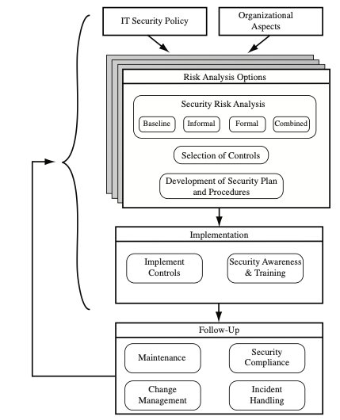
IT Security Management is a Cyclic Process
Cyclic process of must be repeated constantly in order to keep pace with the rapid changes in both IT technology and the risk environment
Notes:
This process is illustrated in Figure 14.1 (adapted from figure 1 in ISO27005 (Information security risk management, 2005) and
figure 1 in ISO13335, part 3]), with a particular
focus on the internal details relating to the risk assessment process. IT security management
needs to be a key part of an organization’s overall management plan. Similarly,
the IT security risk assessment process should be incorporated into the wider risk
assessment of all the organization’s assets and business processes. Hence, unless senior
management in an organization are aware of, and support, this process, it is unlikely
that the desired security objectives will be met and contribute appropriately to the
organization’s business outcomes. Note that IT management is not something undertaken
just once. Rather it is a cyclic process that must be repeated constantly in order
to keep pace with the rapid changes in both IT technology and the risk environment.

Slide 52
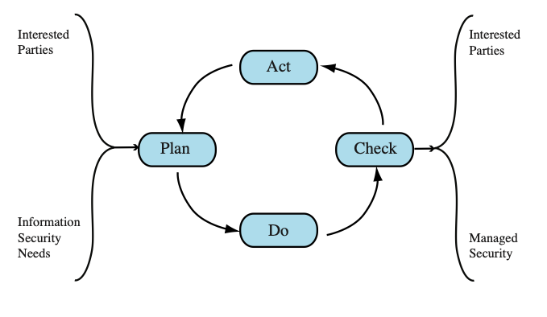
Plan – Do – Check - Act Process Model
Plan: Establish security policy, objectives, processes and procedures; perform risk assessment; develop risk treatment plan with appropriate selection of controls or acceptance of risk
Do: Implement the risk treatment plan
Check: Monitor and maintain the risk treatment plan
Act: Maintain and improve the information security risk management
process in response to incidents, review, or identified changes
Notes:
This process is illustrated in Figure 14.1 (adapted from figure 1 in ISO27005 (Information security risk management, 2005) and
figure 1 in ISO13335, part 3]), with a particular
focus on the internal details relating to the risk assessment process. IT security management
needs to be a key part of an organization’s overall management plan. Similarly,
the IT security risk assessment process should be incorporated into the wider risk
assessment of all the organization’s assets and business processes. Hence, unless senior
management in an organization are aware of, and support, this process, it is unlikely
that the desired security objectives will be met and contribute appropriately to the
organization’s business outcomes. Note that IT management is not something undertaken
just once. Rather it is a cyclic process that must be repeated constantly in order
to keep pace with the rapid changes in both IT technology and the risk environment.

Slide 53
Organizational Context and Security Policy
Maintained and updated regularly
Using periodic security reviews
Reflect changing technical/risk environments
Examine role and importance of IT systems in organization
Which essential decisions depend on the accuracy, currency, integrity, or availability of data managed by the IT systems?
What data created, managed, processed, and stored by the IT systems need protection?
What are the consequences to the organization of a security failure in their IT systems?
First examine organization’s IT security:
Objectives - wanted IT security outcomes
Strategies - how to meet objectives
Policies - identify what needs to be done
Notes:
The initial step in the IT security management process comprises an examination of
the organization’s IT security objectives, strategies, and policies in the context of the
organization’s general risk profile. This can only occur in the context of the wider
organizational objectives and policies, as part of the management of the organization.
Organizational security objectives identify what IT security outcomes should be
achieved. They need to address individual rights, legal requirements, and standards
imposed on the organization, in support of the overall organizational objectives.
Organizational security strategies identify how these objectives can be met. Organizational
security policies identify what needs to be done. These objectives, strategies, and
policies need to be maintained and regularly updated based on the results of periodic
security reviews to reflect the constantly changing technological and risk environments.
To help identify these organizational security objectives, the role and importance
of the IT systems in the organization is examined. The value of these systems
in assisting the organization achieve its goals is reviewed, not just the direct costs of
these systems. Questions that help clarify these issues include the following:
• What key aspects of the organization require IT support in order to function
efficiently?
• What tasks can only be performed with IT support?
• Which essential decisions depend on the accuracy, currency, integrity, or
availability of data managed by the IT systems?
• What data created, managed, processed, and stored by the IT systems need
protection?
• What are the consequences to the organization of a security failure in their IT
systems?
If the answers to some of the above questions show that IT systems are important
to the organization in achieving its goals, then clearly the risks to them should be
assessed and appropriate action taken to address any deficiencies identified. A list
of key organization security objectives should result from this examination.
Once the objectives are listed, some broad strategy statements can be developed.
These outline in general terms how the identified objectives will be met in a consistent
manner across the organization. The topics and details in the strategy statements
depend on the identified objectives, the size of the organization, and the importance
of the IT systems to the organization. The strategy statements should address the
approaches the organization will use to manage the security of its IT systems.

Slide 54
Organizational Security Policy
Needs to be addressed:
Scope and purpose including relation of objectives to business, legal, regulatory requirements
IT security requirements of assets (in terms of CIA triad)
Assignment of responsibilities across the organizational structure
Risk management approach
Security awareness and training
Integration of security into systems development
Information classification scheme
Contingency and business continuity planning
Incident detection and handling processes
How and when policy reviewed, and change control to it
Notes:
Given the organizational security objectives and strategies, an organizational
security policy is developed that describes what the objectives and strategies are and
the process used to achieve them. The organizational or corporate security policy
may be either a single large document or, more commonly, a set of related documents.
This policy typically needs to address at least the following topics:
• The scope and purpose of the policy
• The relationship of the security objectives to the organization’s legal and
regulatory obligations, and its business objectives
• IT security requirements in terms of confidentiality, integrity, availability,
accountability, authenticity, and reliability, particularly with regard to the
views of the asset owners
• The assignment of responsibilities relating to the management of IT security
and the organizational infrastructure
• The risk management approach adopted by the organization
• How security awareness and training is to be handled
• General personnel issues, especially for those in positions of trust
• Any legal sanctions that may be imposed on staff, and the conditions under
which such penalties apply
• Integration of security into systems development and procurement
• Definition of the information classification scheme used across the organization
• Contingency and business continuity planning
• Incident detection and handling processes
• How and when this policy should be reviewed
• The method for controlling changes to this policy
The intent of the policy is to provide a clear overview of how an organization’s IT
infrastructure supports its overall business objectives in general, and more specifically
what security requirements must be provided in order to do this most
effectively.

Slide 55
Security Risk Assessment
Critical component of process in IT security management
Ideally examine every organizational asset
Not feasible in practice
The time and effort required, even for large, well-resourced organizations, is clearly neither achievable nor cost effective
Approaches to identifying and mitigating risks to an organization’s IT infrastructure:
Baseline approach
Informal approach
Detailed risk analysis
Combined approach
Notes:
We now turn to the key risk management component of the IT security process.
This stage is critical, because without it there is a significant chance that resources
will not be deployed where most effective. The result will be that some risks are
not addressed, leaving the organization vulnerable, while other safeguards may be
deployed without sufficient justification, wasting time and money. Ideally every
single organizational asset is examined, and every conceivable risk to it is evaluated.
If a risk is judged to be too great, then appropriate remedial controls are deployed to
reduce the risk to an acceptable level. In practice this is clearly impossible. The time
and effort required, even for large, well-resourced organizations, is clearly neither
achievable nor cost effective. Even if possible, the rapid rate of change in both IT
technologies and the wider threat environment means that any such assessment
would be obsolete as soon as it is completed, if not earlier! Clearly some form of
compromise evaluation is needed.
Another issue is the decision as to what constitutes an appropriate level of
risk to accept. In an ideal world the goal would be to eliminate all risks completely.
Again, this is simply not possible. A more realistic alternative is to expend an amount
of resources in reducing risks proportional to the potential costs to the organization
should that risk occur. This process also must take into consideration the likelihood
of the risk’s occurrence. Specifying the acceptable level of risk is simply prudent
management and means that resources expended are reasonable in the context of
the organization’s available budget, time, and personnel resources. The aim of the
risk assessment process is to provide management with the information necessary for
them to make reasonable decisions on where available resources will be deployed.
Given the wide range of organizations, from very small businesses to global
multinationals and national governments, there clearly needs to be a range of alternatives
available in performing this process. There are a range of formal standards that
detail suitable IT security risk assessment processes, including ISO 13335, ISO 27005,
ISO 31000, and NIST SP 800-30. In particular, ISO 13335 recognizes four approaches
to identifying and mitigating risks to an organization’s IT infrastructure:
• Baseline approach
• Informal approach
• Detailed risk analysis
• Combined approach
The choice among these will be determined by the resources available to the organization
and from an initial high-level risk analysis that considers how valuable the IT systems
are and how critical to the organization’s business objectives. Legal and regulatory
constraints may also require specific approaches. This information should be determined
when developing the organization’s IT security objectives, strategies, and policies.

Slide 56
Baseline Approach
Goal is to implement agreed controls to provide protection against the most common threats
Forms a good base for further security measures
Use “industry best practice”
Easy, cheap, can be replicated
Gives no special consideration to variations in risk exposure
May give too much or too little security due to rough baseline
Generally recommended only for small organizations without the resources to implement more structured approaches
Notes:
The baseline approach to risk assessment aims to implement a basic general level
of security controls on systems using baseline documents, codes of practice, and
industry best practice . The advantages of this approach are that it doesn’t require
the expenditure of additional resources in conducting a more formal risk assessment
and that the same measures can be replicated over a range of systems. The
major disadvantage is that no special consideration is given to variations in the organization’s
risk exposure based on who they are and how their systems are used.
Also, there is a chance that the baseline level may be set either too high, leading to
expensive or restrictive security measures that may not be warranted, or set too low,
resulting in insufficient security and leaving the organization vulnerable.

Slide 57
Informal Approach
Involves conducting an informal, pragmatic risk analysis on organization’s IT systems
Exploits knowledge and expertise of analyst
Fairly quick and cheap
Judgments can be made about vulnerabilities and risks that baseline approach would not address
Some risks may be incorrectly assessed
Skewed by analyst’s views, varies over time
Suitable for small to medium sized organizations where IT systems are not necessarily essential
Notes:
The informal approach involves conducting some form of informal, pragmatic risk
analysis for the organization’s IT systems. This analysis does not involve the use of
a formal, structured process, but rather exploits the knowledge and expertise of the
individuals performing this analysis. These may either be internal experts, if available,
or, alternatively, external consultants. A major advantage of this approach is
that the individuals performing the analysis require no additional skills. Hence, an
informal risk assessment can be performed relatively quickly and cheaply. In addition,
because the organization’s systems are being examined, judgments can be
made about specific vulnerabilities and risks to systems for the organization that
the baseline approach would not address. Thus more accurate and targeted controls
may be used than would be the case with the baseline approach. There are a number
of disadvantages. Because a formal process is not used, there is a chance that some
risks may not be considered appropriately, potentially leaving the organization vulnerable.
Besides, because the approach is informal, the results may be skewed by the
views and prejudices of the individuals performing the analysis. It may also result in
insufficient justification for suggested controls, leading to questions over whether
the proposed expenditure is really justified. Lastly, there may be inconsistent results
over time as a result of differing expertise in those conducting the analysis.
The use of the informal approach would generally be recommended for small
to medium-sized organizations where the IT systems are not necessarily essential to
meeting the organization’s business objectives and where additional expenditure on
risk analysis cannot be justified.

Slide 58
Detailed Risk Analysis (Formal Process)
Most comprehensive approach
Assess using formal structured process
Number of stages
Identify threats and vulnerabilities to assets
Identify likelihood of risk occurring and consequences
Significant cost in time, resources, expertise
May be a legal requirement to use
Suitable for large organizations with IT systems critical to their business objectives
Notes:
The third and most comprehensive approach is to conduct a detailed risk assessment
of the organization’s IT systems, using a formal structured process. This provides
the greatest degree of assurance that all significant risks are identified and their
implications considered. This process involves a number of stages, including
identification of assets, identification of threats and vulnerabilities to those assets,
determination of the likelihood of the risk occurring and the consequences to the
organization should that occur, and hence the risk the organization is exposed to. With
that information, appropriate controls can be chosen and implemented to address
the risks identified. The advantages of this approach are that it provides the most
detailed examination of the security risks of an organization’s IT system, and produces
strong justification for expenditure on the controls proposed. It also provides
the best information for continuing to manage the security of these systems as they
evolve and change. The major disadvantage is the significant cost in time, resources,
and expertise needed to perform such an analysis. The time taken to perform this
analysis may also result in delays in providing suitable levels of protection for some
systems. The details of this approach are discussed in the next section.
The use of a formal, detailed risk analysis is often a legal requirement for
some government organizations and businesses providing key services to them. This
may also be the case for organizations providing key national infrastructure. For
such organizations, there is no choice but to use this approach. It may also be the
approach of choice for large organizations with IT systems critical to their business
objectives and with the resources available to perform this type of analysis.

Slide 59
Combined Approach
Combines elements of the baseline, informal, and detailed risk analysis approaches
Aim is to provide reasonable levels of protection as quickly as possible and adjust the protection controls deployed on key systems over time
Approach starts with the implementation of suitable baseline security recommendations on all systems
Next, systems either exposed to high risk levels or critical to the organization's business objectives are identified in the high-level risk assessment
A decision can then be made to possibly conduct an immediate informal risk assessment on key systems, with the aim of relatively quickly tailoring controls to more accurately reflect their requirements
Lastly, an ordered process of performing detailed risk analyses of these systems can be instituted
Over time, this can result in the most appropriate and cost-effective security controls being selected and implemented on these systems
Notes:
The last approach combines elements of the baseline, informal, and detailed risk
analysis approaches. The aim is to provide reasonable levels of protection as quickly
as possible, and then to examine and adjust the protection controls deployed on key
systems over time. The approach starts with the implementation of suitable baseline
security recommendations on all systems. Next, systems either exposed to high risk
levels or critical to the organization’s business objectives are identified in the high-level
risk assessment. A decision can then be made to possibly conduct an immediate
informal risk assessment on key systems, with the aim of relatively quickly
tailoring controls to more accurately reflect their requirements. Lastly, an ordered
process of performing detailed risk analyses of these systems can be instituted. Over
time this can result in the most appropriate and cost-effective security controls being
selected and implemented on these systems. This approach has a significant number
of advantages. The use of the initial high-level analysis to determine where further
resources need to be expended, rather than facing a full detailed risk analysis of
all systems, may well be easier to sell to management. It also results in the development
of a strategic picture of the IT resources and where major risks are likely
to occur. This provides a key planning aid in the subsequent management of the
organization’s security. The use of the baseline and informal analyses ensures that a
basic level of security protection is implemented early. And it means that resources
are likely to be applied where most needed and that systems most at risk are likely
to be examined further reasonably early in the process. However, there are some
disadvantages. If the initial high-level analysis is inaccurate, then some systems for
which a detailed risk analysis should be performed may remain vulnerable for some
time. Nonetheless, the use of the baseline approach should ensure a basic minimum
security level on such systems. Further, if the results of the high-level analysis are
reviewed appropriately, the chance of lingering vulnerability is minimized.
ISO13335 considers that for most organizations, in most circumstances, this
approach is the most cost effective. Consequently its use is highly recommended.

Slide 60
Detailed Risk Analysis
Provides the most accurate evaluation of an organization's IT system’s security risks
Highest cost
Initially focused on addressing defense security concerns
Often mandated by government organizations and associated businesses
Notes:
The formal, detailed security risk analysis approach provides the most accurate
evaluation of an organization’s IT system’s security risks, but at the highest cost.
This approach has evolved with the development of trusted computer systems,
initially focused on addressing defense security concerns, as we discuss in Chapter 13 .
The original security risk assessment methodology was given in the Yellow Book
standard (CSC-STD-004-85 June 1985), one of the original U.S. TCSEC rainbow
book series of standards. Its focus was entirely on protecting the confidentiality of
information, reflecting the military concern with information classification. The
recommended rating it gave for a trusted computer system depended on difference
between the minimum user clearance and the maximum information classification.
Specifically it defined a risk index as
Risk Index = Max Info Sensitivity - Min User Clearance
A table in this standard, listing suitable categories of systems for each risk level,
was used to select the system type. Clearly this limited approach neither adequately
reflects the range of security services required nor the wide range of possible threats.
Over the years since, the process of conducting a security risk assessment that does
consider these issues has evolved.

Slide 61
Threat Identification
Availability
Authenticity
Reliability
Accountability
Integrity
Threat is Anything that might hinder or prevent an asset from providing appropriate levels of the key security services
Confidentiality
Notes:
Answering the first of these questions involves
identifying potential threats to assets. In the broadest sense, a threat is anything
that might hinder or prevent an asset from providing appropriate levels of the key
security services: confidentiality, integrity, availability, accountability, authenticity,
and reliability. Note that one asset may have multiple threats, and a single threat
may target multiple assets.

Slide 62
Risk Treatment Alternatives
Risk acceptance
Choosing to accept a risk level greater than normal for business reasons
Risk avoidance
Not proceeding with the activity or system that creates this risk
Risk transfer
Sharing responsibility for the risk with a third party
Reduce consequence
Modifying the structure or use of the assets at risk to reduce the impact on the organization should the risk occur
Reduce likelihood
Implement suitable controls to lower the chance of the vulnerability being exploited
The loss of this capability is traded off against the reduced risk profile
E.g., taking out insurance against the risk occurring, by entering into a contract with another organization
E.g., implementing an off-site backup process, developing a disaster recovery plan, or arranging for data and processing to be replicated over multiple sites
E.g., include technical or administrative controls such as deploying firewalls and access tokens, or change policies
Notes:
There are five broad alternatives
available to management for treating identified risks:
Risk acceptance: Choosing to accept a risk level greater than normal for business
reasons. This is typically due to excessive cost or time needed to treat the
risk. Management must then accept responsibility for the consequences to the
organization should the risk eventuate.
• Risk avoidance: Not proceeding with the activity or system that creates this
risk. This usually results in loss of convenience or ability to perform some
function that is useful to the organization. The loss of this capability is traded
off against the reduced risk profile.
• Risk transfer: Sharing responsibility for the risk with a third party. This is
typically achieved by taking out insurance against the risk occurring, by entering
into a contract with another organization, or by using partnership or joint
venture structures to share the risks and costs should the threat eventuate.
• Reduce consequence: By modifying the structure or use of the assets at risk
to reduce the impact on the organization should the risk occur. This could
be achieved by implementing controls to enable the organization to quickly
recover should the risk occur. Examples include implementing an off-site
backup process, developing a disaster recovery plan, or arranging for data and
processing to be replicated over multiple sites.
• Reduce likelihood: By implementing suitable controls to lower the chance of
the vulnerability being exploited. These could include technical or administrative
controls such as deploying firewalls and access tokens, or procedures such
as password complexity and change policies. Such controls aim to improve the
security of the asset, making it more difficult for an attack to succeed by reducing the
vulnerability of the asset.
If either of the last two options is chosen, then possible treatment controls
need to be selected and their cost effectiveness evaluated. There is a wide range
of available management, operational, and technical controls that may be used.
These would be surveyed to select those that might address the identified threat
most effectively and to evaluate the cost to implement against the benefit gained.
Management would then choose among the options as to which should be adopted
and plan for their implementation. We introduce the range of controls often used
and the use of security plans and policies in Chapter 15 and provide further details
of some specific control areas in Chapters 16 – 18 .

Slide 63
Analyze Risks
Specify likelihood of occurrence of each identified threat to asset given existing controls
Specify consequence should threat occur
Derive overall risk rating for each threat
Risk = probability threat occurs x cost to organization
Hard to determine accurate probabilities and realistic cost consequences
Use qualitative and quantitative ratings, heat maps
Notes:
Having identified key assets and the likely threats and vulnerabilities they are
exposed to, the next step is to determine the level of risk each of these poses to the
organization. The aim is to identify and categorize the risks to assets that threaten
the regular operations of the organization. Risk analysis also provides information
to management to help managers evaluate these risks and determine how best to
treat them. Risk analysis involves first specifying the likelihood of occurrence of
each identified threat to an asset, in the context of any existing controls. Next, the
consequence to the organization is determined, should that threat eventuate. Lastly,
this information is combined to derive an overall risk rating for each threat. The
ideal would be to specify the likelihood as a probability value and the consequence
as a monetary cost to the organization should it occur. The resulting risk is then
simply given as
Risk = (Probability that threat occurs) x (Cost to organization)
This can be directly equated to the value the threatened asset has for the organization,
and hence specify what level of expenditure is reasonable to reduce the
probability of its occurrence to an acceptable level. Unfortunately, it is often
extremely hard to determine accurate probabilities, realistic cost consequences,
or both. This is particularly true of intangible assets, such as the loss of confidentiality
of a trade secret. Hence, most risk analyses use qualitative, rather than
quantitative, ratings for both these items. The goal is then to order the resulting
risks to help determine which need to be most urgently treated, rather than to
give them an absolute value.

Slide 64
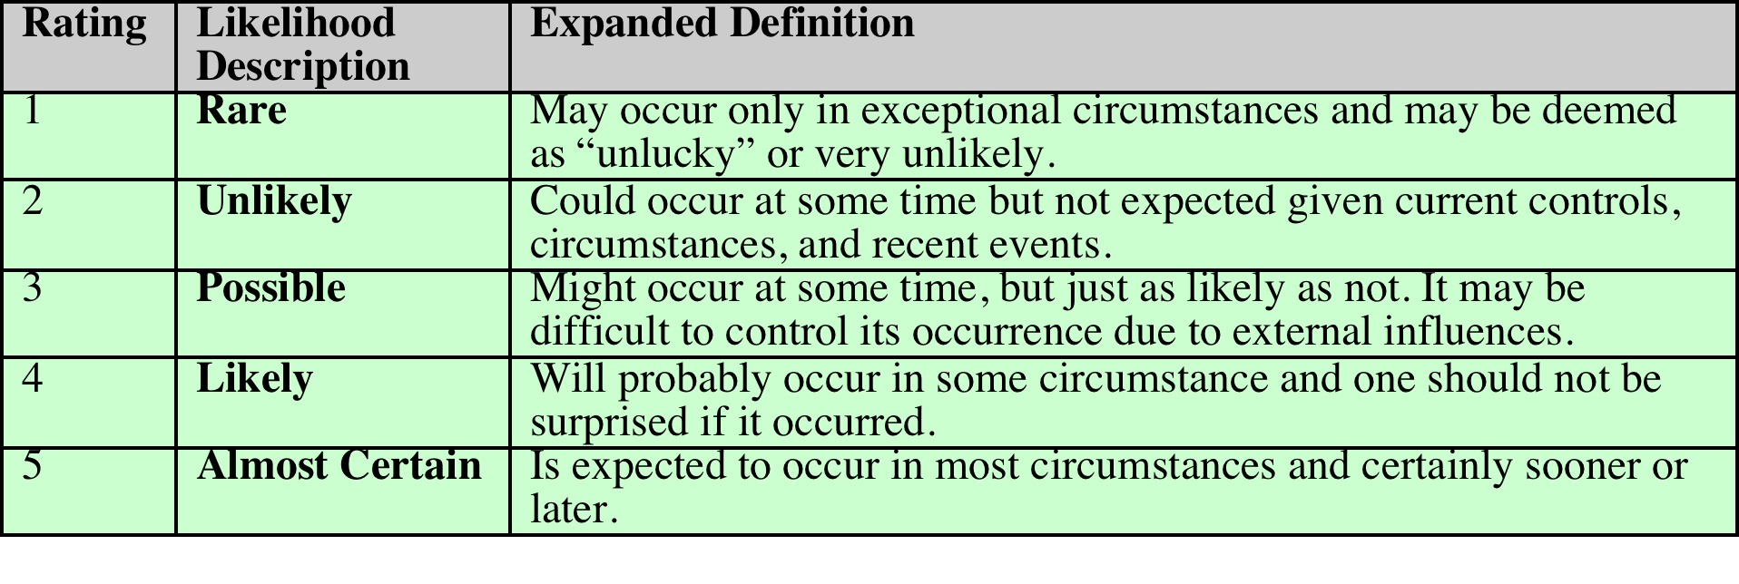
Risk Likelihood
There will very likely be some uncertainty and debate over exactly which rating is most appropriate
This reflects the qualitative nature of the ratings, ambiguity in their precise meaning, and uncertainty over precisely how likely it is that some threat may eventuate
It is important to remember that the goal of this process is to provide guidance to management as to which risks exist, and provide enough information to help management decide how to most appropriately respond
Notes:
Having identified existing controls, the likelihood
that each identified threat could occur and cause harm to some asset needs to
be specified. The likelihood is typically described qualitatively, using values and
descriptions such as those shown in Table 14.2. While the various risk assessment
standards all suggest tables similar to these, there is considerable variation in their
detail. The selection of the specific descriptions and tables used is determined at
the beginning of the risk assessment process, when the context is established.
There will very likely be some uncertainty and debate over exactly which rating
is most appropriate. This reflects the qualitative nature of the ratings, ambiguity
in their precise meaning, and uncertainty over precisely how likely it is that some
threat may eventuate. It is important to remember that the goal of this process is
to provide guidance to management as to which risks exist, and provide enough
information to help management decide how to most appropriately respond. Any
uncertainty in the selection of ratings should be noted in the discussion on their
selection, but ultimately management will make a business decision in response to
this information.
The risk analyst takes the descriptive asset and threat/vulnerability details
from the preceding steps in this process and, in light of the organization’s overall
risk environment and existing controls, decides the appropriate rating. This
estimation relates to the likelihood of the specified threat exploiting one or
more vulnerabilities to an asset or group of assets, which results in harm to the
organization. The specified likelihood needs to be realistic. In particular, a rating
of likely or higher suggests that this threat has occurred sometime previously. This
means past history provides supporting evidence for its specification. If this is
not the case, then specifying such a value would need to be justified on the basis
of a significantly changed threat environment, a change in the IT system that
has weakened its security, or some other rationale for the threat’s anticipated
likely occurrence. In contrast, the Unlikely and Rare ratings can be very hard to
quantify. They are an indication that the threat is of concern, but whether it could
occur is difficult to specify. Typically such threats would only be considered if the
consequences to the organization of their occurrence are so severe that they must
be considered, even if extremely improbable.

Slide 65
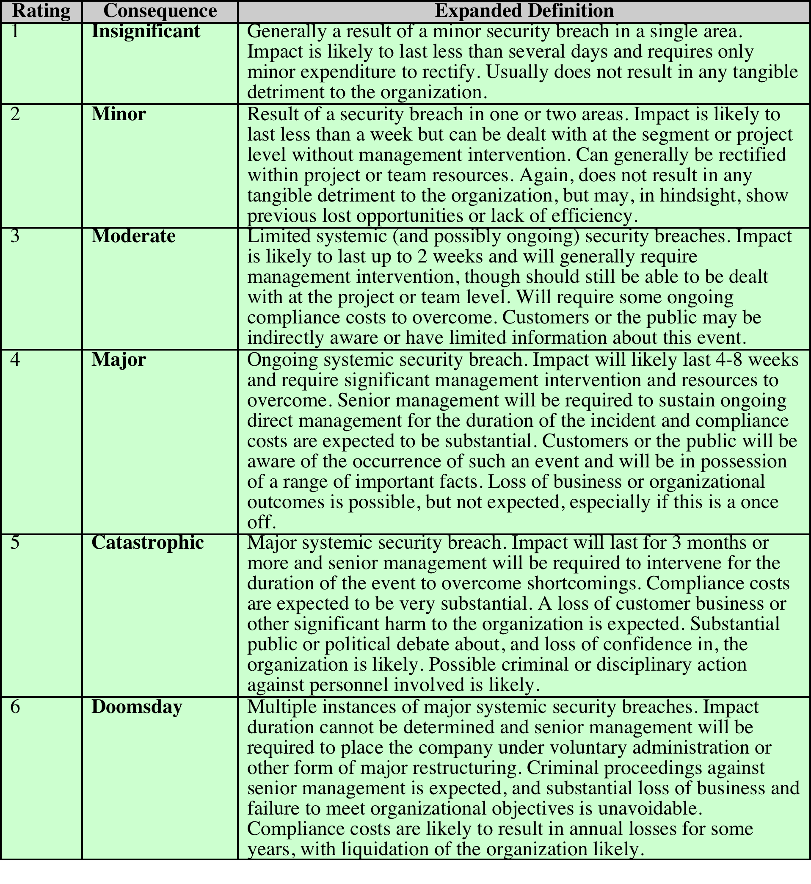
Risk Consequences
Notes:
The analyst must then
specify the consequence of a specific threat eventuating. Note this is distinct from,
and not related to, the likelihood of the threat occurring. Rather, consequence
specification indicates the impact on the organization should the particular threat
in question actually eventuate. Even if a threat is regarded as rare or unlikely, if
the organization would suffer severe consequence should it occur, then it clearly
poses a risk to the organization. Hence, appropriate responses must be considered.
A qualitative descriptive value, such as those shown in Table 14.3, is typically used
to describe the consequence. As with the likelihood ratings, there is likely to be
some uncertainty as to the best rating to use.
This determination should be based upon the judgment of the asset’s owners,
and the organization’s management, rather than the opinion of the risk analyst. This
is in contrast with the likelihood determination. The specified consequence needs to
be realistic. It must relate to the impact on the organization as a whole should this
specific threat eventuate. It is not just the impact on the affected system. It is possible
that a particular system (a server in one location, for example) might be completely
destroyed in a fire. However, the impact on the organization could vary from it being
a minor inconvenience (the server was in a branch office, and all data were replicated
elsewhere) to a major disaster (the server had the sole copy of all customer
and financial records for a small business). As with the likelihood ratings, the consequence
ratings must be determined knowing the organization’s current practices and
arrangements. In particular, the organization’s existing backup, disaster recovery,
and contingency planning, or lack thereof, will influence the choice of rating.

Slide 66
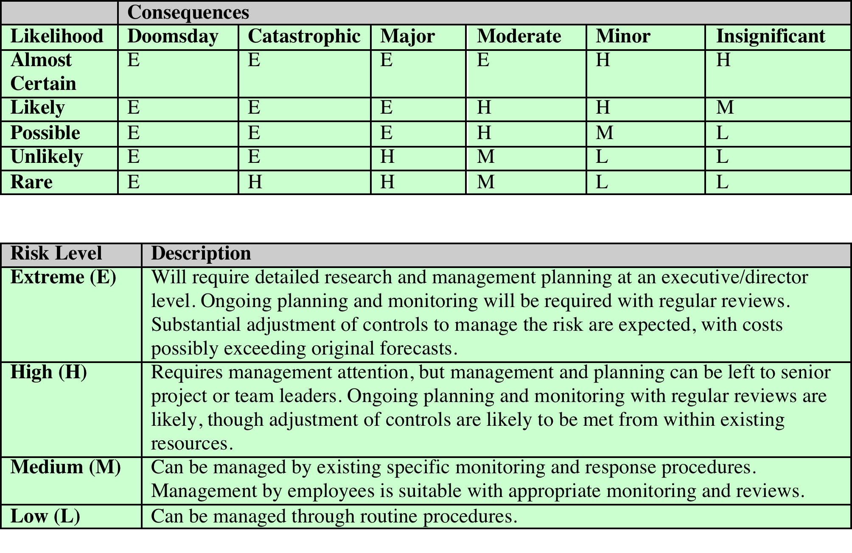
Risk Level Determination
***https://www.ready.gov/business/planning/risk-assessment
Notes:
Once the likelihood and consequence
of each specific threat have been identified, a final level of risk can be assigned.
This is typically determined using a table that maps these values to a risk level,
such as those shown in Table 14.4. This table details the risk level assigned to each
combination. Such a table provides the qualitative equivalent of performing the
ideal risk calculation using quantitative values. It also indicates the interpretation
of these assigned levels.

